Slide 1
DSPG 2019
TOSS Updates
Gizem Korkmaz, Bayoan Calderon, Cong Cong, Eliza Tobin, Calvin Isch
Sponsor: Carol Robbins, National Science Foundation, National Center for Science and Engineering Statistics

Slide 2
Outline
Problem Statement
OSS Definition
License info
Universe Definition
Data Source: GitHub
Data Collection Methods (pros cons)
Final Dataset Coverage (even if it s not finished)
Today’s Focus: 2015 -- Profiling & Exploration
  Repo counts (2012,2015,2018) totals → Eliza
  Repo counts by license → Calvin & Eliza
  Number of contributors, commits for 2015 →Eliza
  Location → Cong
  Company → Cong
  Networks (maybe) → Brandon
Interpretation of findings
Notes:
Defining and measuring the universe of ope source software innovation: What is OSS? What is a universe?
Universe: scope right now is U.S. even though we acknowledge that OSS often has no boundaries – relevant to the issue of economic measurement in U.S. so focusing on that right now
NOTES: is copyright a good measurement of OSS innovation?
-add foreign sector
Software License: "A software license tells others what they can and can't do with your source code" (Github)

Slide 3

OSS Definition
Open Source Software (OSS): "a computer software, with its source code made available with a license, in which the copyright holder provides the rights to study, change, and distribute the software to anyone and for any purpose." (Open Source Initiative)
Notes:
Defining and measuring the universe of ope source software innovation: What is OSS? What is a universe?
Universe: scope right now is U.S. even though we acknowledge that OSS often has no boundaries – relevant to the issue of economic measurement in U.S. so focusing on that right now
NOTES: is copyright a good measurement of OSS innovation?
-add foreign sector
Software License: "A software license tells others what they can and can't do with your source code" (Github)

Slide 4
Copyrights

Slide 5

Overview Continued
Issue: There are no commonly used metrics to measure the amount of open source software (OSS) in existence and OSS is not captured in the nation's gross domestic product (GDP)
Goals:
  Amount in existence
    Longitudinal comparisons
  Identify developers (who creates OSS?)
  Measure research output of OSS by sector
Universe: All registered open source software
Notes:
ISSUE:
current economic indicators do not measure the value of goods and services that do not have market transactions
not captured in surveys nor are in economics measures such as the Gross Domestic Product (GDP).
Want a fuller understanding of innovation/OSS innovation
GOALS
Measure the amount of OSS data in existence, especially for purposes of longitudinal comparison
Origin: who creates OSS? What is distribution across different groups? - identify 5 sectors: we care because business OSS
OSS is a type of research output (there is money going into this but OSS is not captured when we look at the ROI on these projects) that comes not only from businesses but other sectors: important to gain a better understanding of this type of research output

Slide 6


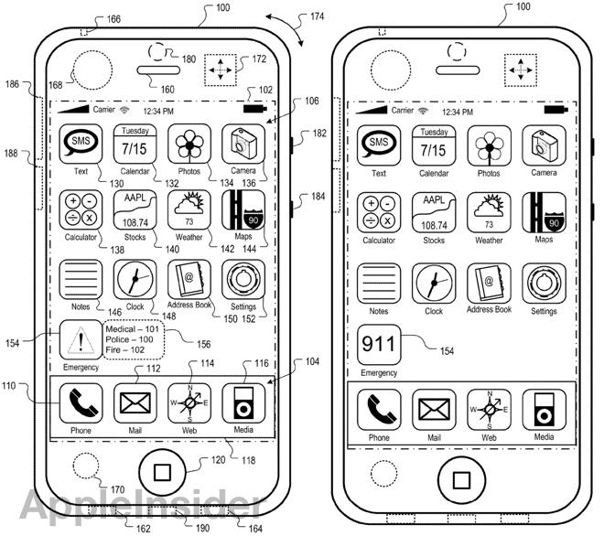
Data Discovery
Licenses define limitations of use
  Product registration: provides developers with claims when licenses are violated
Three traditional ways to register innovation:
Copyright
  Trademark
  Patent
Notes:
People have licenses to define limitations of how other people can use their software (terms of use), people also register the products so that people can have claims when licenses are violated... there are 3 traditional ways to register innovation
3 typical ways to register innovation/products --> 3 traditional ways innovation is measured: copyright, trademark, patent

Slide 7

Copyright Data Discovery
First step: investigate software copyrighted in U.S.
  Copyright: "a form of protection provided by the laws of the United States to the authors of ‘original works of authorship’ that are fixed in a tangible form of expression” (U.S. Copyright Office)
Why?
  Accessible
  Some copyrighted computer files are OSS
Is Copyright a Good Measure of the Universe of OSS?
Notes:
Decided to look at computer file copyright on copyright.gov because it is accessible – will look at the other two next
Some copyrighted computer files are OSS
Good way to measure universe of OSS?
Also wanted to see if computer file copyright was a good way to measure OSS innovation – is computer file copyright a good candidate for our universe?

Slide 8

Copyright Data Description & Collection
Data Scraping:
U.S. Copyright Office through Library of Congress
Program: For every year, visits every page of copyright data in order to retrieve the HTML elements of all "computer files"
2000 – 2014
110,650 copyrights scraped
Put data into our database
Notes:
Program written that, for each year, visits every page of copyright data and scrapes the elements (EX. Title, copyright claimant as seen below)
First started with data scraping of computer files from the U.S. copyright office
Extracted data from the U.S. copyright office website
Program written that, for each year, visits every page of copyright data and scrapes the elements (EX. Title, copyright claimant as seen below)
Put into our database

Slide 9
Copyright Data Exploration
Can we identify sectors that developed software?
Can we identify OSS in the computer file copyrights?
Are copyrights a good measure of the OSS universe?
Copyrights
Computer
files
OSS

Slide 10
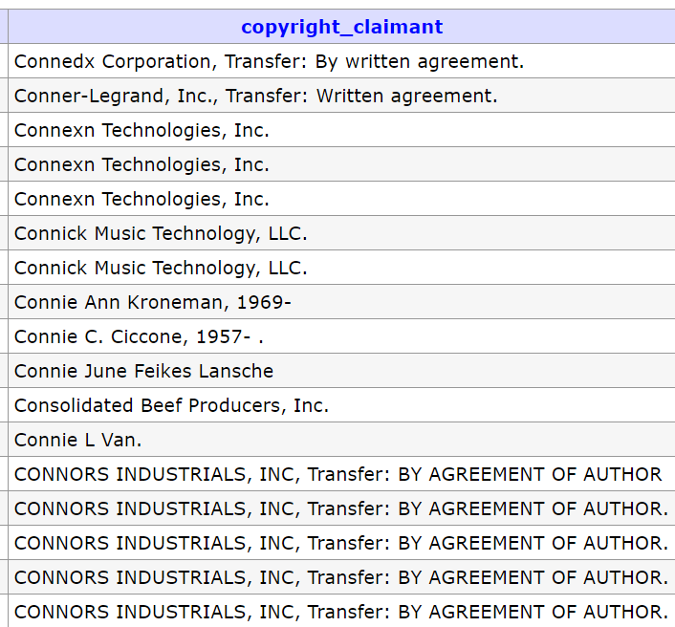
Copyright Claimants Categorization
Can we identify sectors who file the copyright?
Names of claimants in the copyright data
Notes:
Unidentified and overlaps

Slide 11
Copyright Claimants Categorization
Can we identify sectors who file the copyright?
Names of claimants in the copyright data
Business
Notes:
Unidentified and overlaps

Slide 12
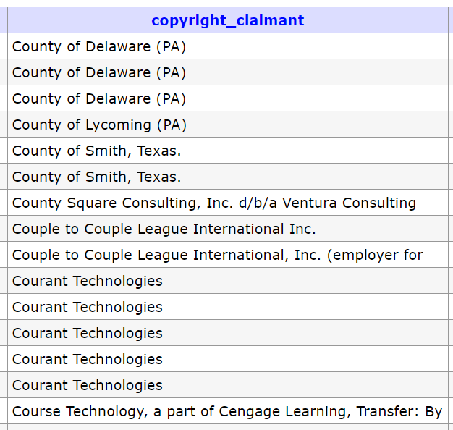
Copyright Claimants Categorization
Can we identify sectors who file the copyright?
Names of claimants in the copyright data
Government
Notes:
Unidentified and overlaps

Slide 13
Copyright Claimants Categorization
Can we identify sectors who file the copyright?
Names of claimants in the copyright data
Individual
Notes:
Unidentified and overlaps

Slide 14
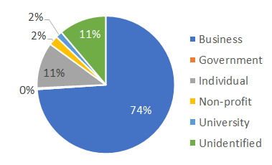
Copyright Claimants Categorization
Identified sectors for 81% of copyright claimants
98% accuracy based on random check
Sector Categorization:
  Business
  Government
  Nonprofits
  Universities
  Individuals
  Foreign
0.3%
Business is the largest sector in copyright records
Notes:
Unidentified and overlaps

Slide 15
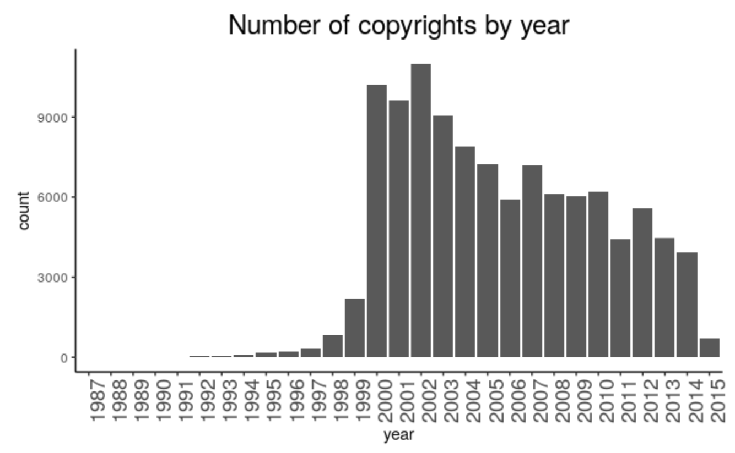
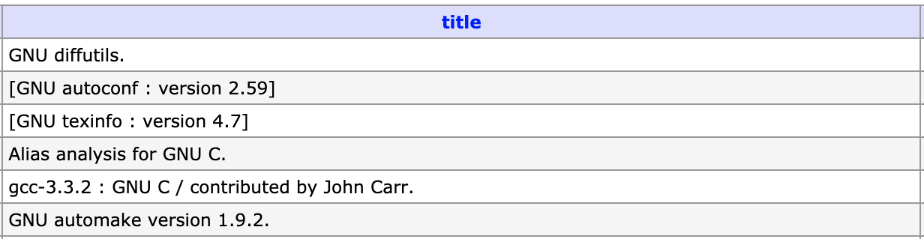
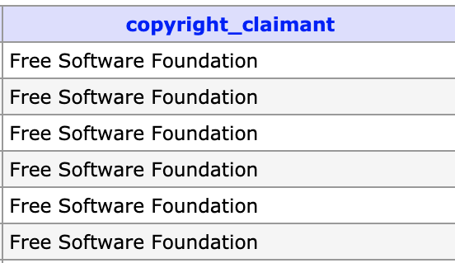
Findings:
Difficulties finding OSS in the decreasing copyrights
Identifying OSS in the data
Queried the database for OSS-identifiable characteristics
  Typical terms: "OSS", "Free Software"
  Licenses: MIT, APACHE, BSD, GNU, GPL
  Large Programs: R, Python, Android
55
The number of computer-file copyright applications is decreasing
Identified so far
Notes:
Give examples of some of the identified OSS

Slide 16
Findings:
Difficulties finding OSS in the decreasing copyrights
Copyrights are NOT a good source for OSS
Identifying OSS in the data
Queried the database for OSS-identifiable characteristics
  Typical terms: "OSS", "Free Software"
  Licenses: MIT, APACHE, BSD, GNU, GPL
  Large Programs: R, Python, Android
55
The number of computer-file copyright applications is decreasing
Identified so far
Notes:
Give examples of some of the identified OSS

Slide 17


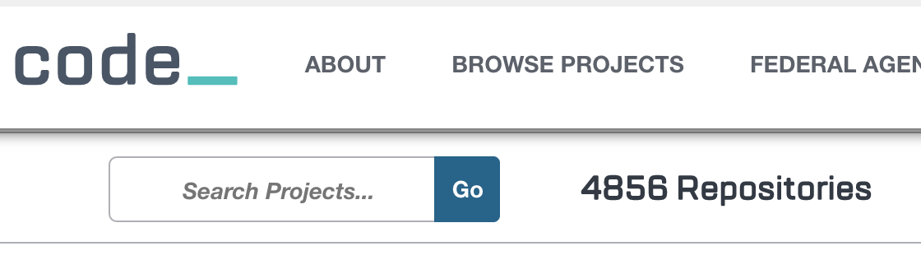
Challenges and Next Steps:
What about Patents and Trademarks?
Explore alternative data sources
Code.gov - Government OSS
  Create government sector universe
  Scrape their repos (GitHub, Bitbucket, SourceForge, etc.)
Redefine the universe
Perhaps registration is not a common practice—change definition of the universe
  GitHub repositories with OSI-approved licenses
Notes:
Other sources don't have equal coverage—and ethics
uspto

